Slide 1

Ben Ratcliff
Competency Portfolio
www.infratec-uk.com

Slide 2
Competency Summary
Category | Accreditation Body | No. | Expiry
Emergency First Aid at Work | Qualsafe | 3531226 | 20/02/2028
Safe Moving and Handling | Qualsafe | 3607288 | 20/03/2028
IPAF 1B | PAL | OP/2752190 | 31/03/2030
Highways Passport | Mitie | 14-00074535 | 08/04/2027
Highways Electrical Registration Scheme (HERS) | HEA | H1249061 | 16/06/2028
www.infratec-uk.com

Slide 3
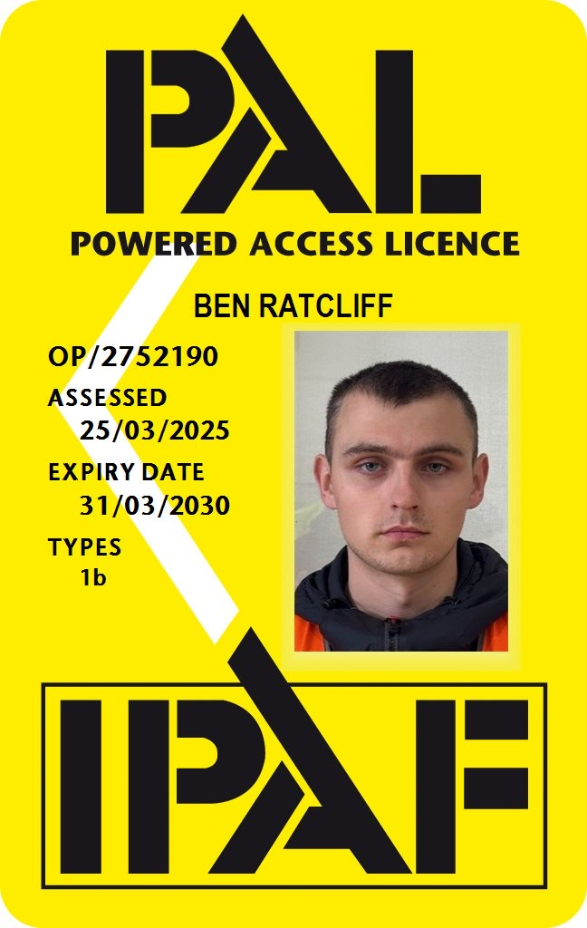
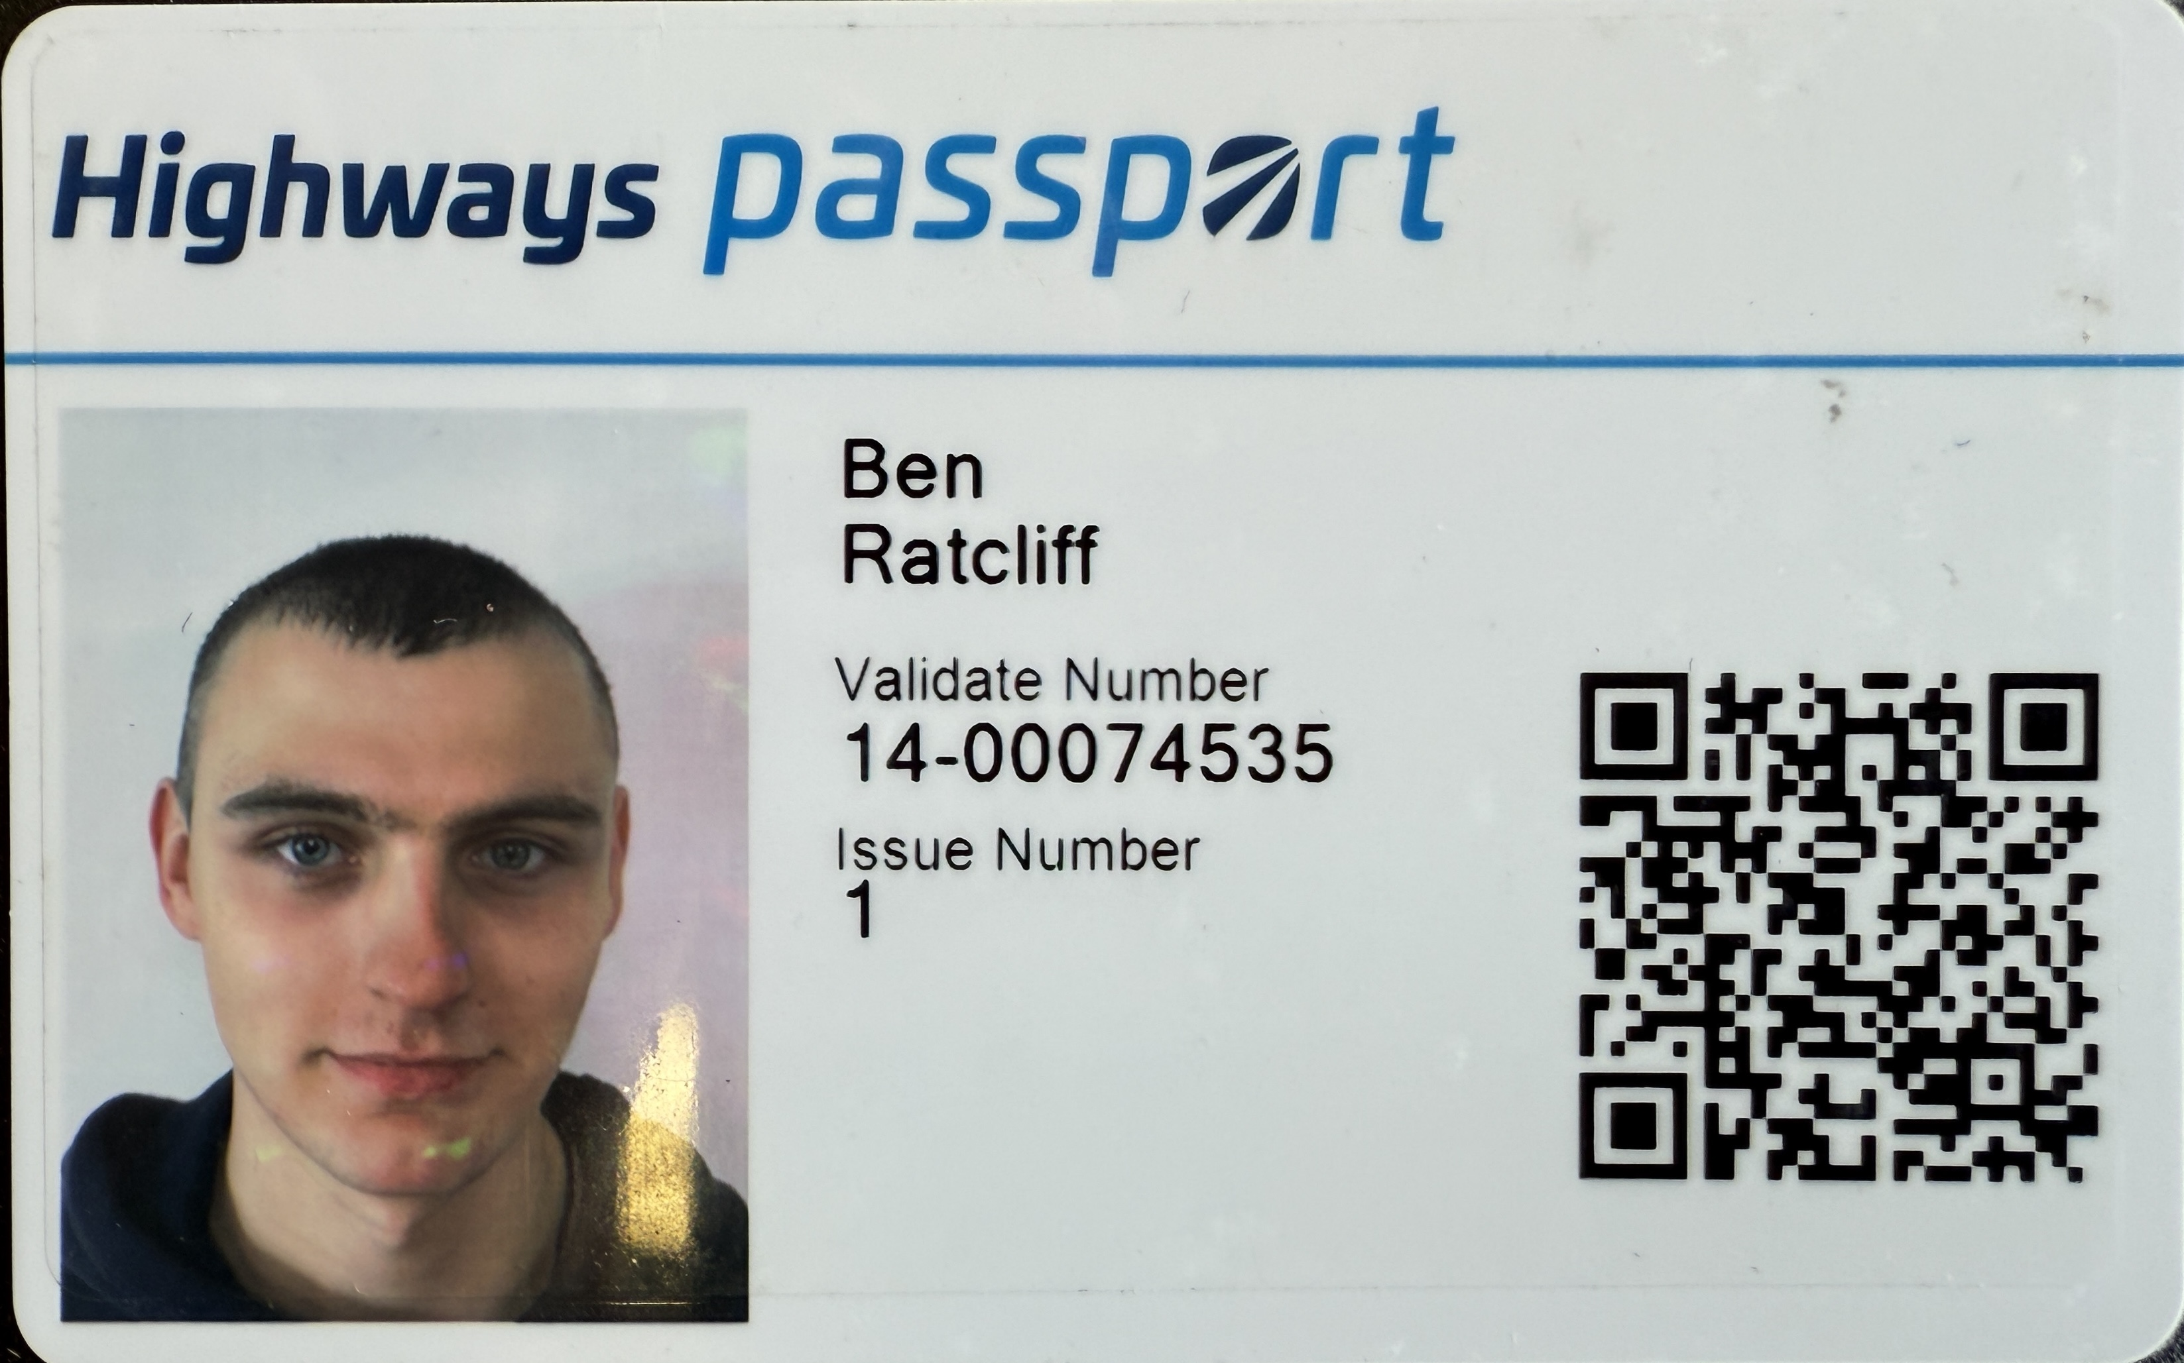
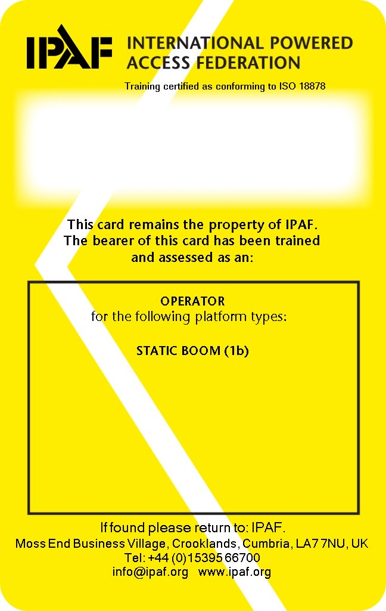
Competency Cards
IPAF
Highways Passport
HERS
www.infratec-uk.com

